Slide 1
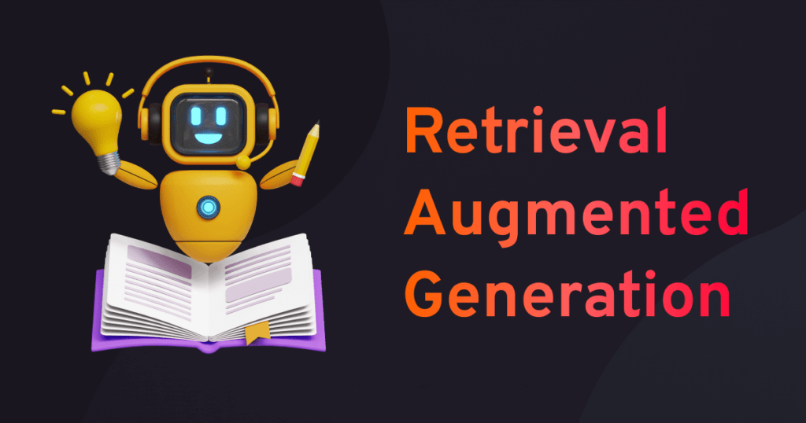
05.06.2025
Jonas Wolber

Slide 2
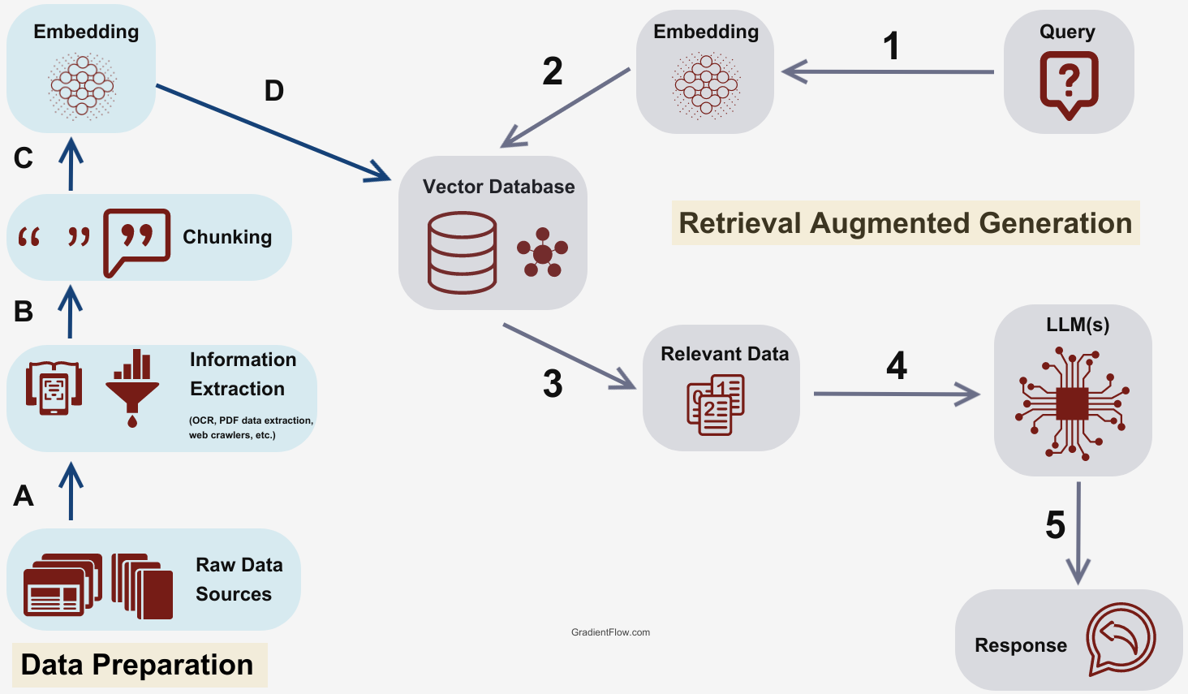
What is Retrieval Augmented Generation (RAG)?
Image taken from: fusionchat.ai/news/10-ways-rag-enhances-ai-systems

Slide 3
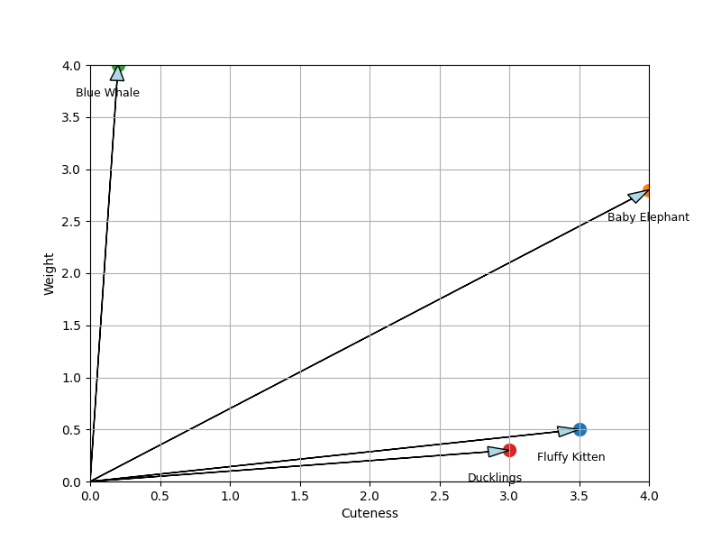
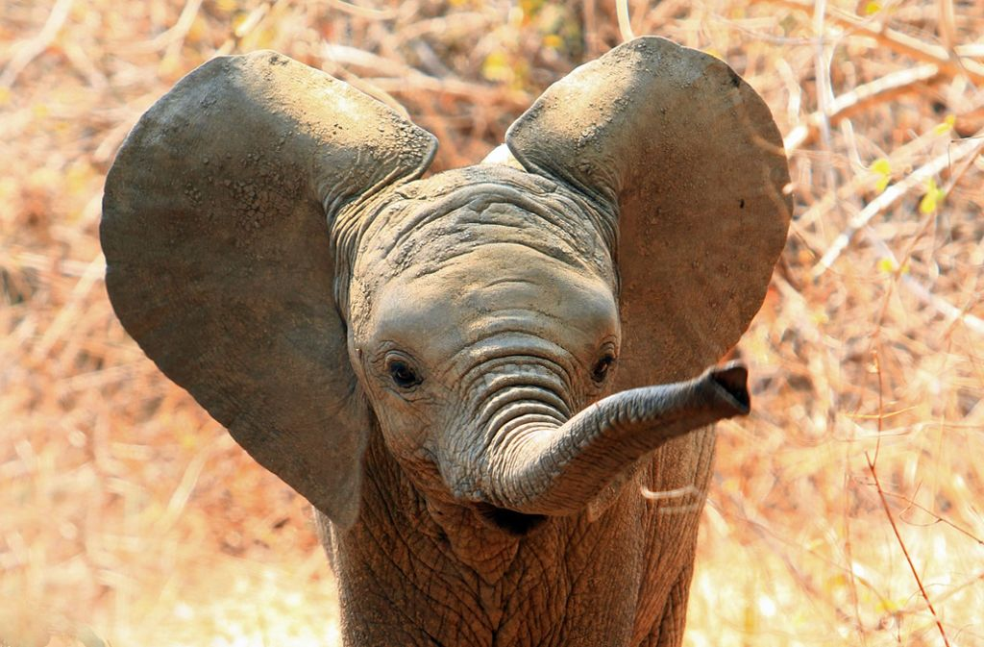
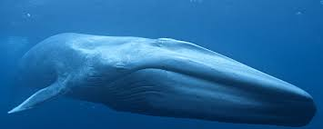
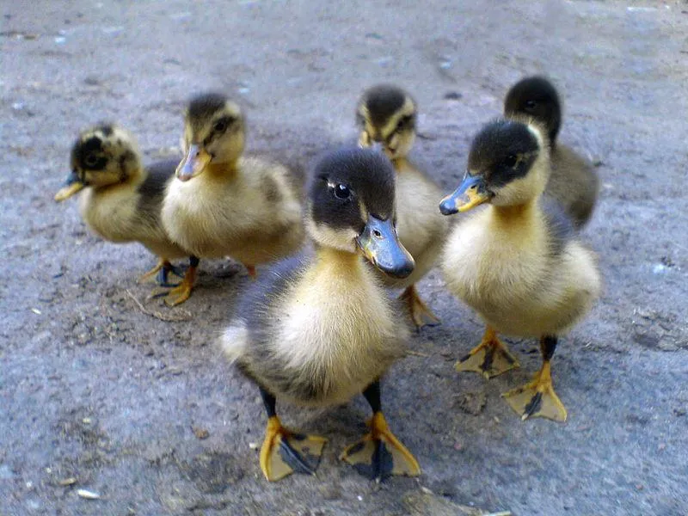

Word embeddings and vector space
Text
"Center for Computational Life Sciences"
Tokenization
Tokens
“Cen“, “ter“, “for“, “Compu“, “tational“, “Life“, “Scien“, “ces“
Embedding
Embeddings
[0.016539961, -0.025933826, 0.048515484, 0.03760145, -0.04732014, -0.002327353, …]

Slide 4





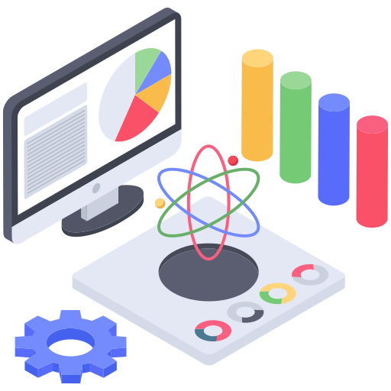
Applications of RAG
Question Answering
Document Summarization
Coding Assistants
Enterprise Knowledge Management
Patient Diagnostics
Scientific Research
Icons made by Freepik, Juicyfish, Dewi Sari, Vectorsmarket from www.flaticon.com

Slide 5
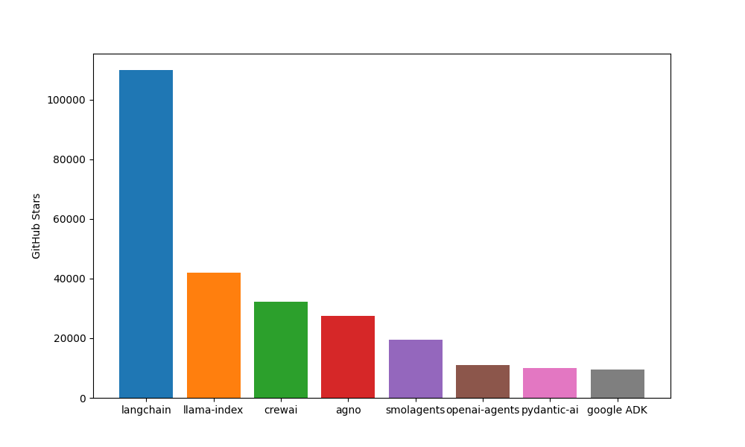

Frameworks for LLMs, RAG and Agentic AI
Beginner-friendly
Lightweight
Fast
Open-source
Flexible

Slide 6
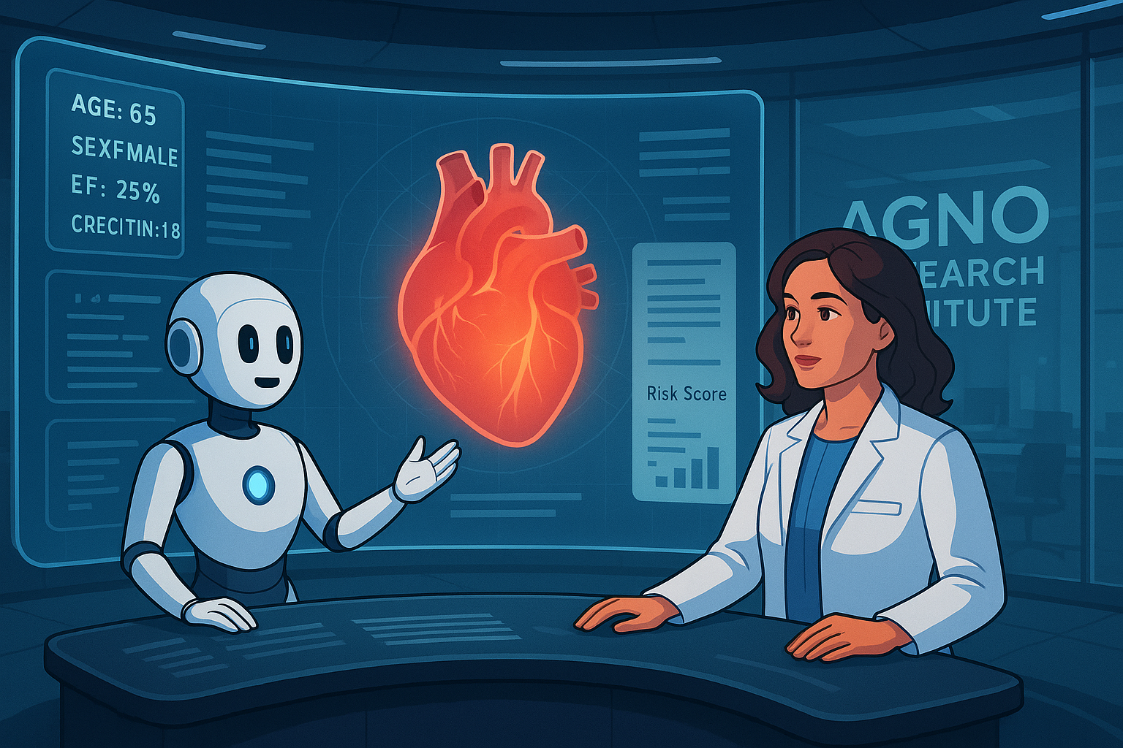
Building our first RAG app
Task
Dr. Cardia, a brilliant but overwhelmed cardiologist has a patient with troubling symptoms: fatigue, chest pain, shortness of breath. His vitals and lab results are confusing. The risk of heart failure looms, but Dr. Cardia isn’t sure which features are most predictive for this patient’s condition—or what the latest research says about key predictors and outcomes.
She found a very interesting scientific article about the risk factors of heart failure but she does not have time to read the whole article.
She asks up to come up with a RAG agent that can quickly and accurately look up information from this article and provide meaningful responses.

Slide 7
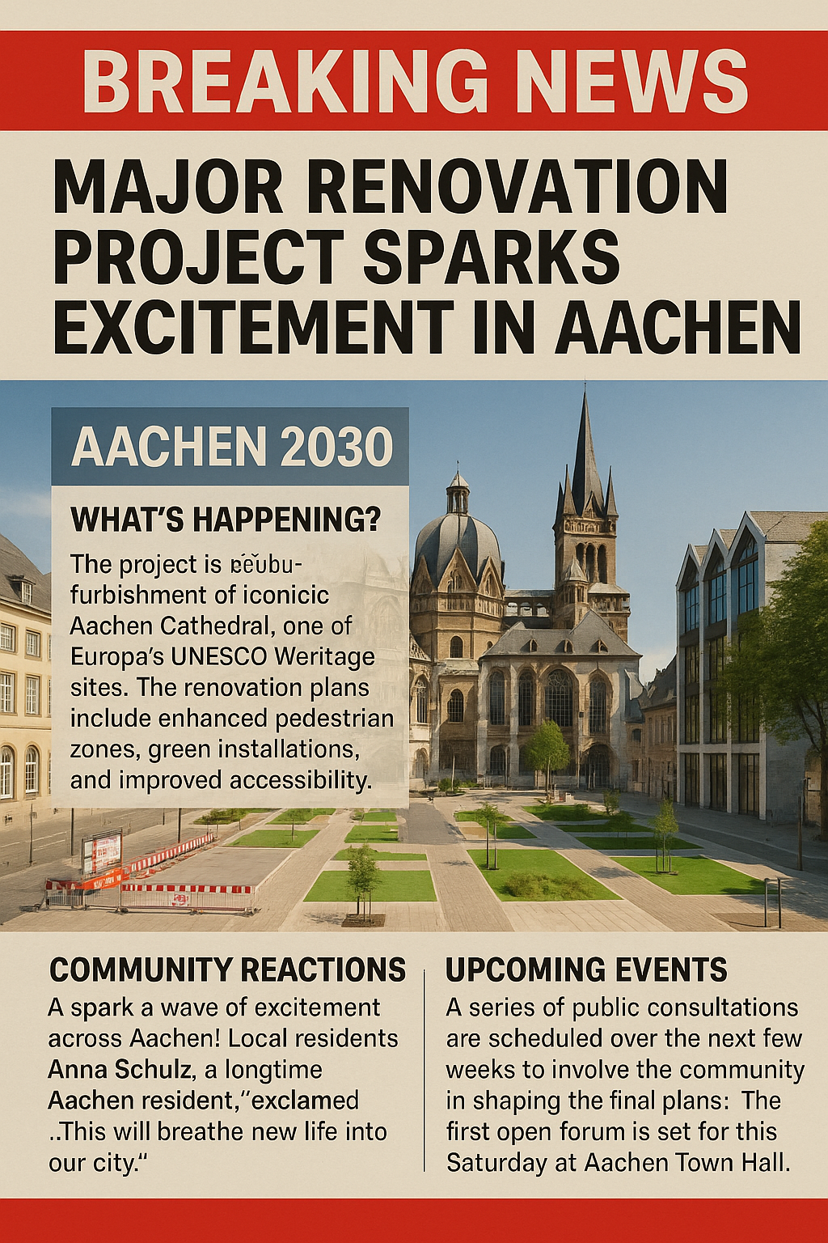
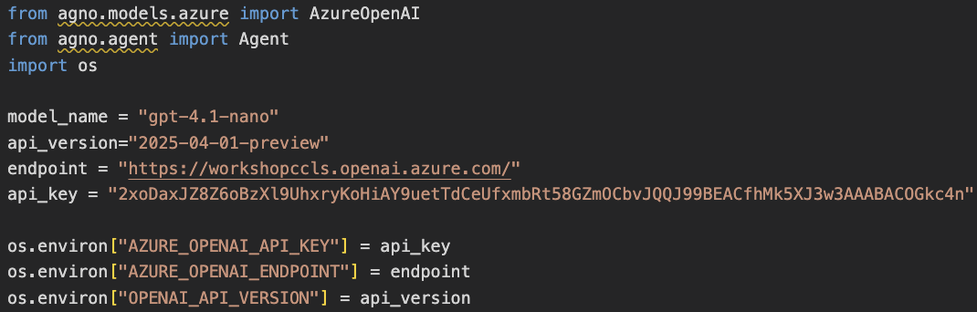
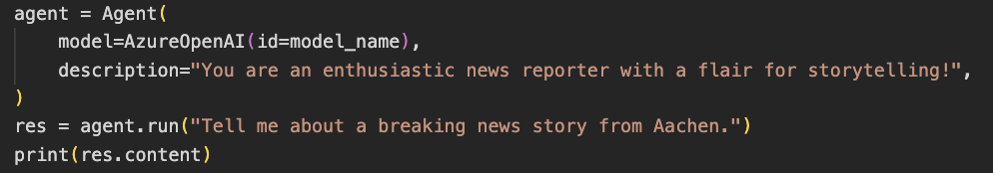
Setting up the Python environment
1. Setting up the environment
2. Install dependencies
3. Set up Azure OpenAI
4. Test

